Slide 1
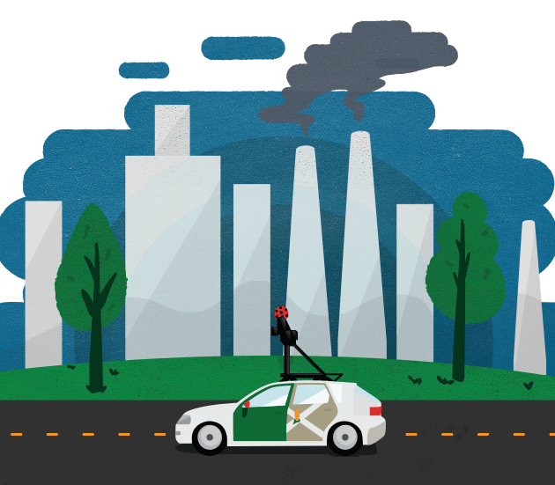
Foundations of Data Science- 11
CRN1501564
Novel Approach for deploying WSNs for efficient fine-grained air quality monitoring
Optimization of Sensor Placement Strategies for Effective Urban Quality Monitoring
Members: Fatima Ali Alobeidli – U23105654 Asma Saif Alkaabi U23201077 Instructor name: Dr, Isam Aljawarneh

Slide 2

Content
Introduction
EDA
Pulp LIP
Result
Architecture
Implementation challenges
Future Work
Survey
Improvement part3

Slide 3

Introduction
Urban air pollution is an ongoing environmental problem that has a big impact on people's health and well-being.
WSN deliver high-resolution spatial data, which makes it possible to monitor air quality in urban areas more precisely.
By implementing some techniques using this data will enhance data quality

Slide 4
Exploratory Data Analysis(EDA)
EDA explore and understand the main characteristics of a dataset
Understand the distribution and patterns of pollution levels
Utilized various statistical measures and visualizations
Analyze the data, including histograms, line plots, and heatmaps.
Identified key trends, seasonal variations, and outliers in the dataset to guide further analysis.

Slide 5
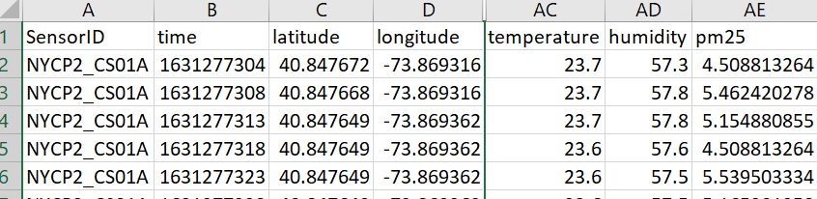

Data
Exploratory Data Analysis(EDA)
SensorID: Captures three sensors
Time: Exploring the year, month, days, hours, and minutes
longitude and latitude are points X and Y, Purpose for attractive map
Pm2.5: Capture of air pollution

Slide 6
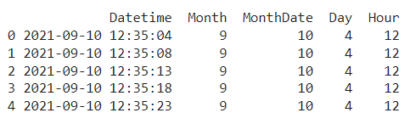
Exploratory Data Analysis(EDA)
Extract from time column the month, month date, day, and hour

Slide 7

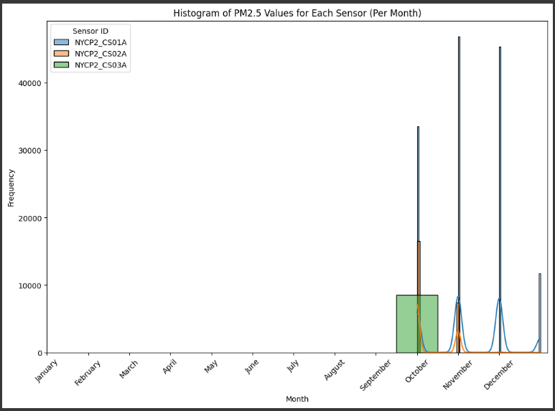
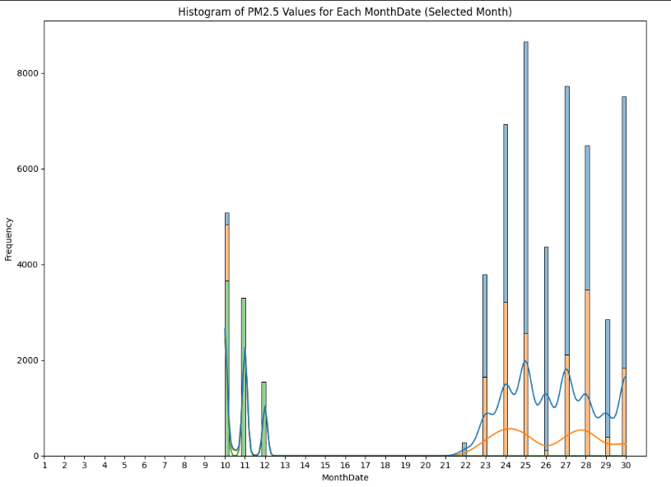
Exploratory Data Analysis(EDA)
Plots

Slide 8
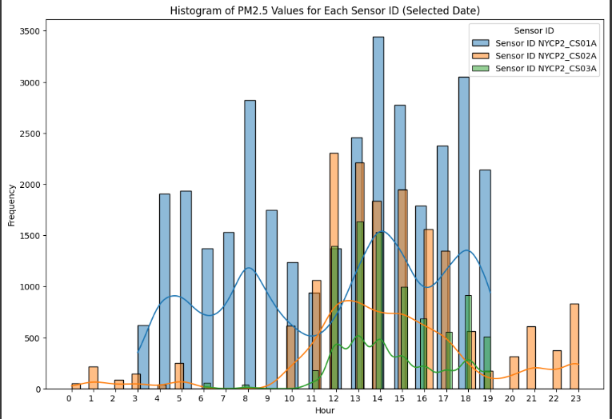
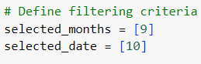
Exploratory Data Analysis(EDA)
Plots

Slide 9
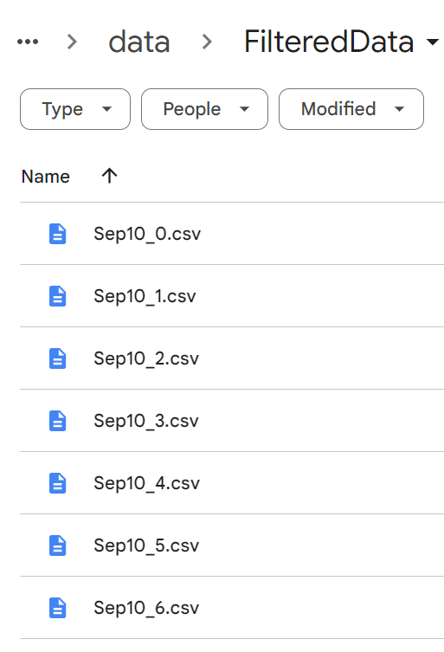

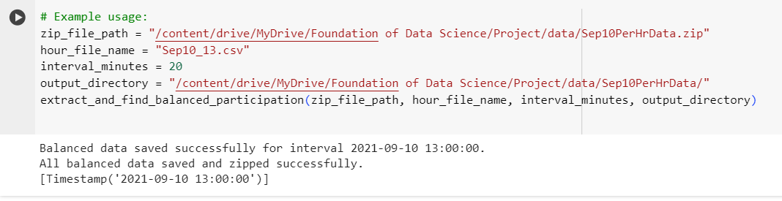

Exploratory Data Analysis(EDA)
The plot takes September month, and date 10
Data will be saved on filtered data folder that contains September month and date 10 from hours range 0 to 23
Then save it a zip file named: Sep10PerHrData.zip
After that, finding the balanced data where an equal number of data points from each hour of the day it will take 20 minutes of 13:00h , saved as a balancedDataSep10_13.zip
Now the data is ready to implement some techniques in aim to have optimal locations.

Slide 10
Pulp integer linear programming
Pulp: likely refers to the PuLP library, which is a popular open-source linear programming (LP) modeling tool in Python.
Finding optimal locations for sensors
Maximum coverage
Minimizing the cost
Enhance data quality
Improve air quality
Overall, pulp enables organizations to make more informed decisions that led to cost reductions and improved efficiency

Slide 11
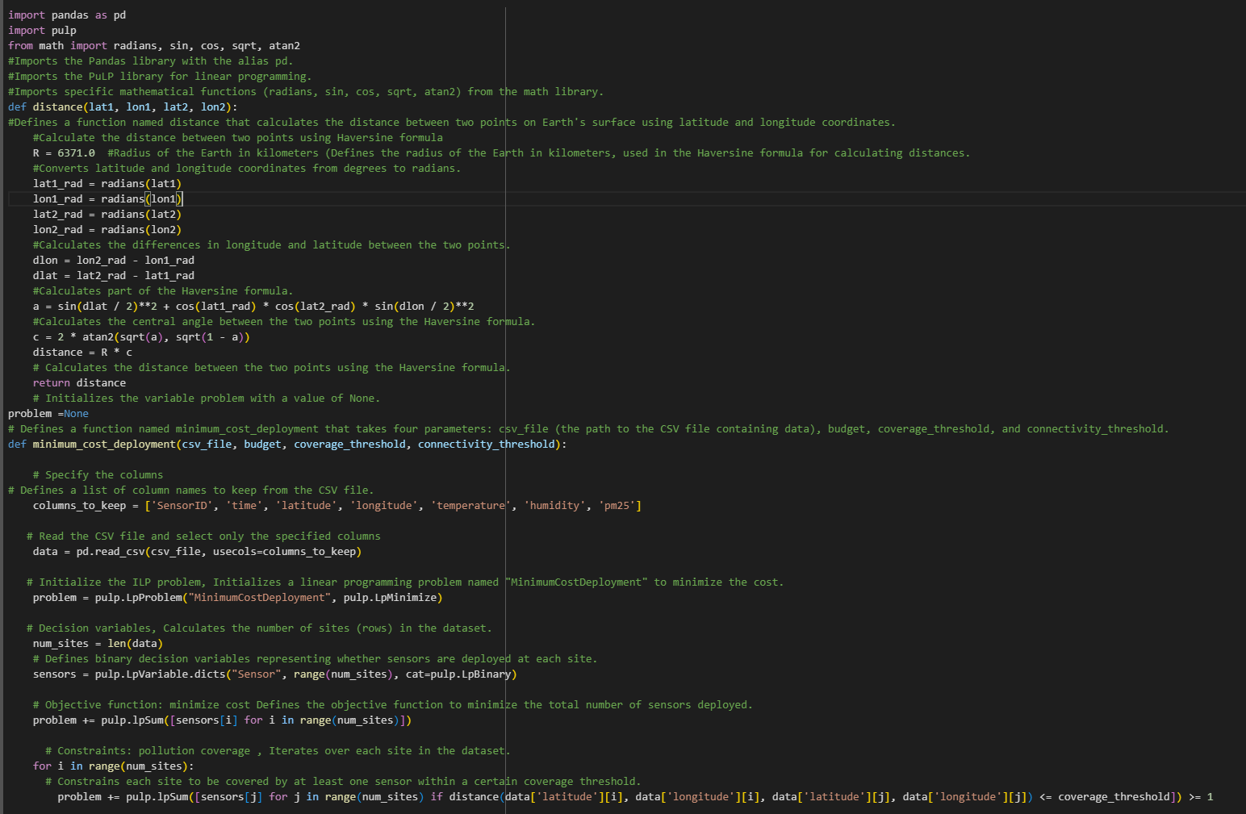
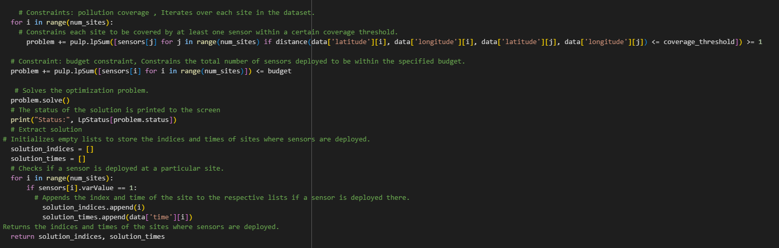
Pulp ILP
Pulp function

Slide 12
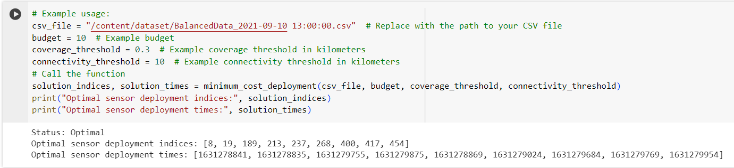
Pulp integer linear programming
Pulp function Result
After the function is proceed successfully we will get the optimal locations

Slide 13

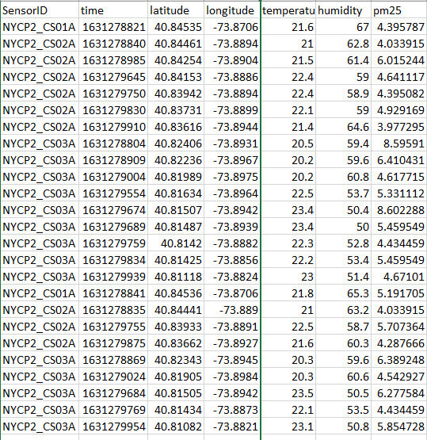

Pulp ILP
Pulp Result

Slide 14

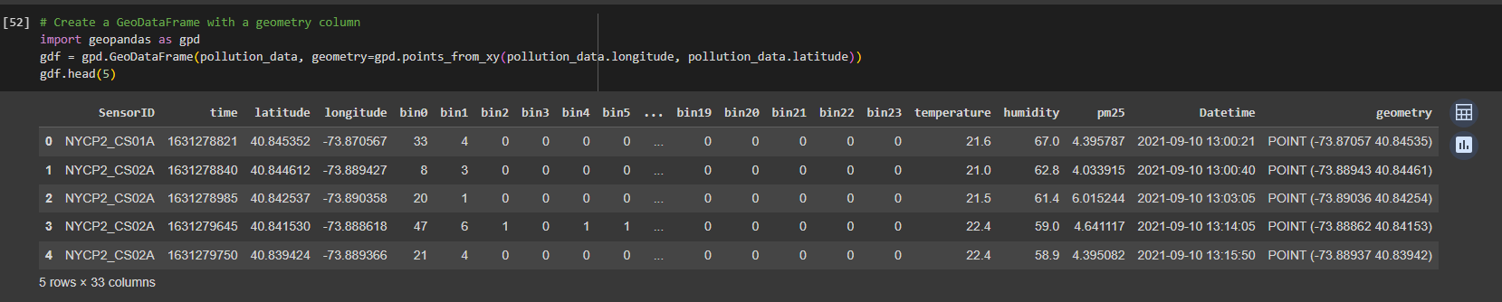
Result
Points

Slide 15
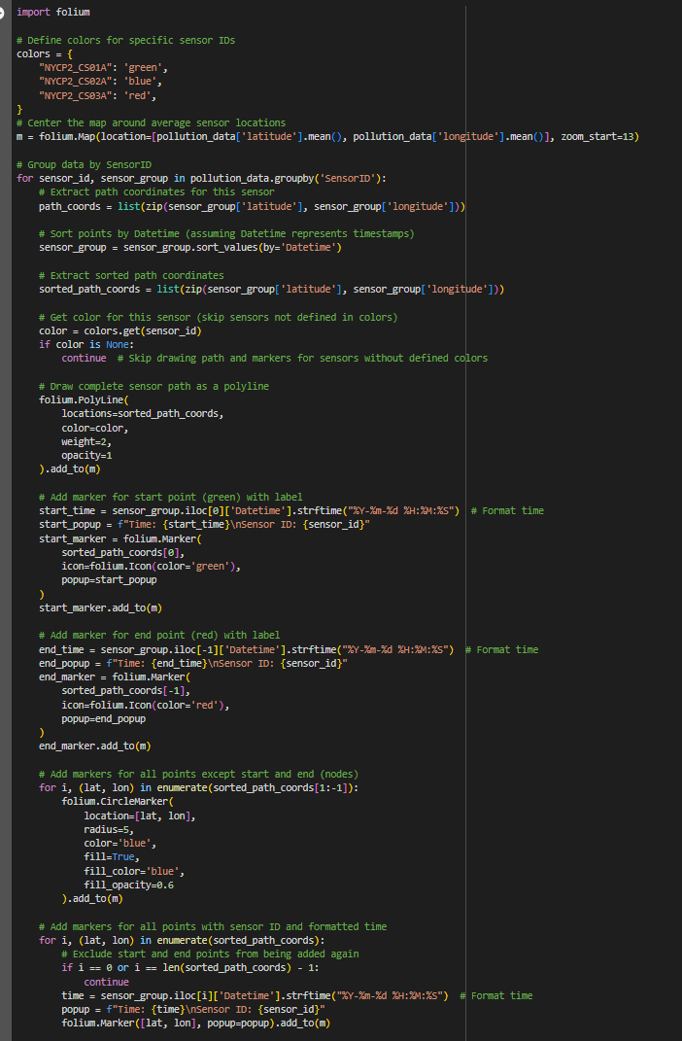
Result
Interactive Map Function

Slide 16
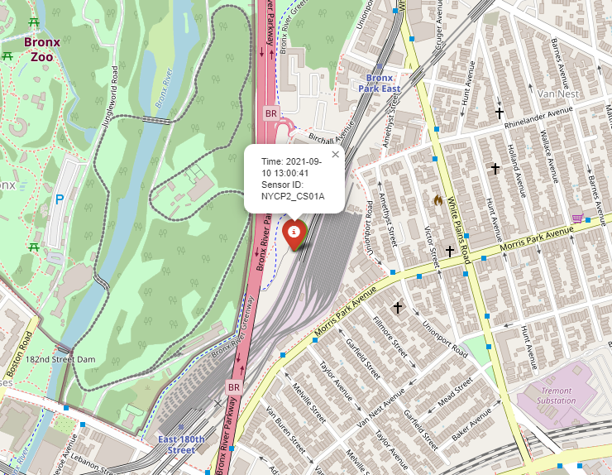
Result
Path Sensor1

Slide 17
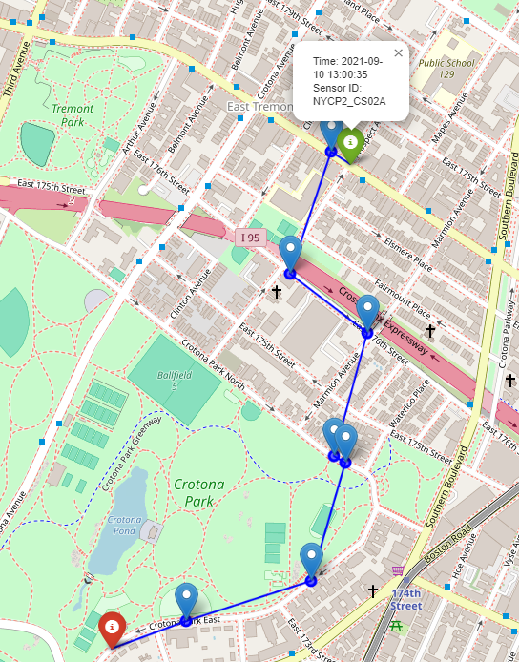
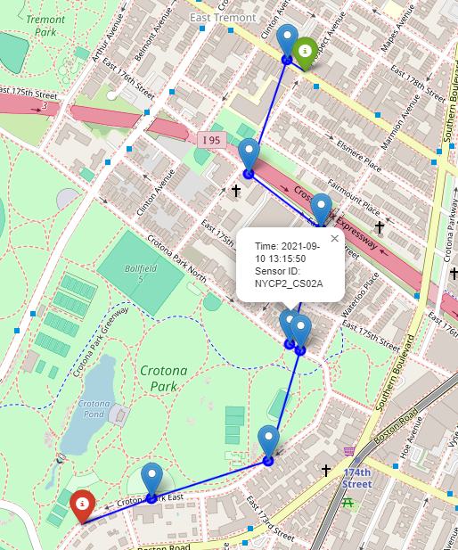
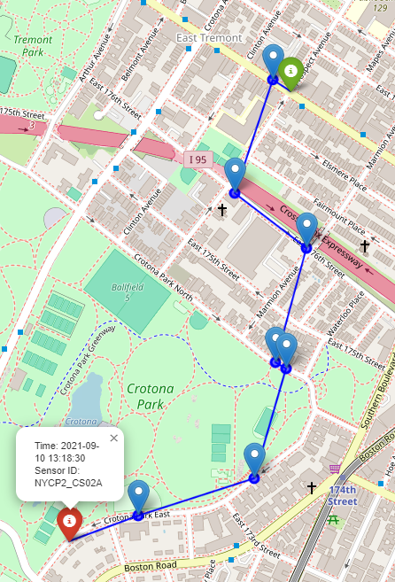
Result
Path Sensor2

Slide 18
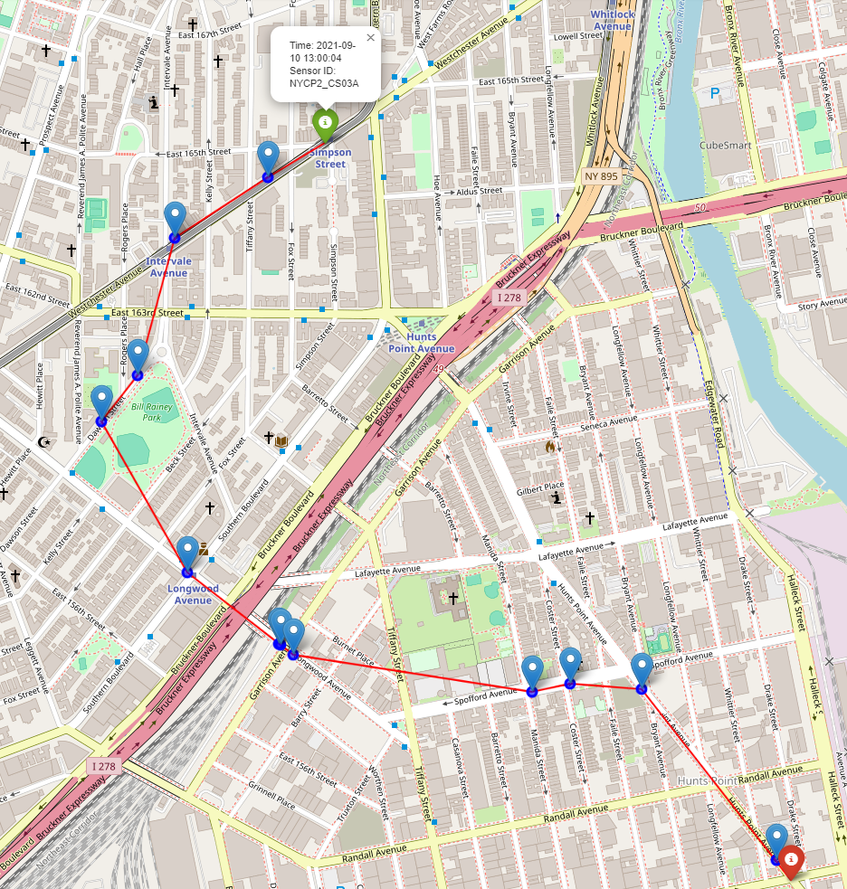
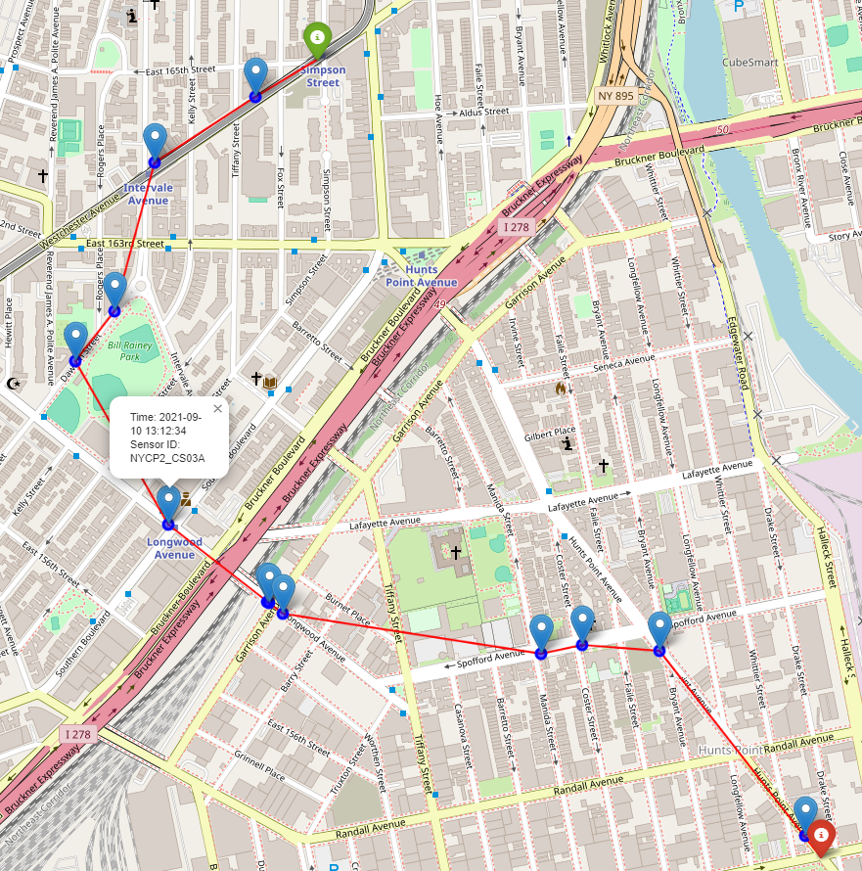
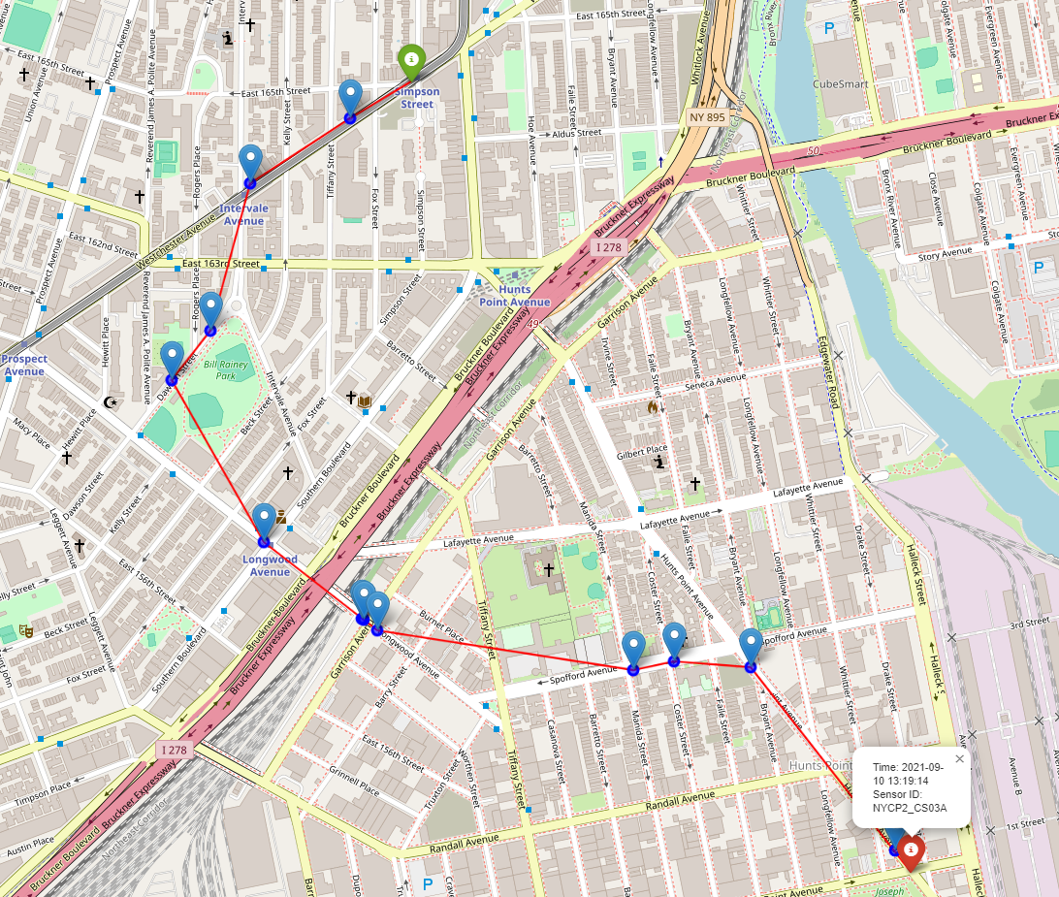
Result
Path Sensor3

Slide 19
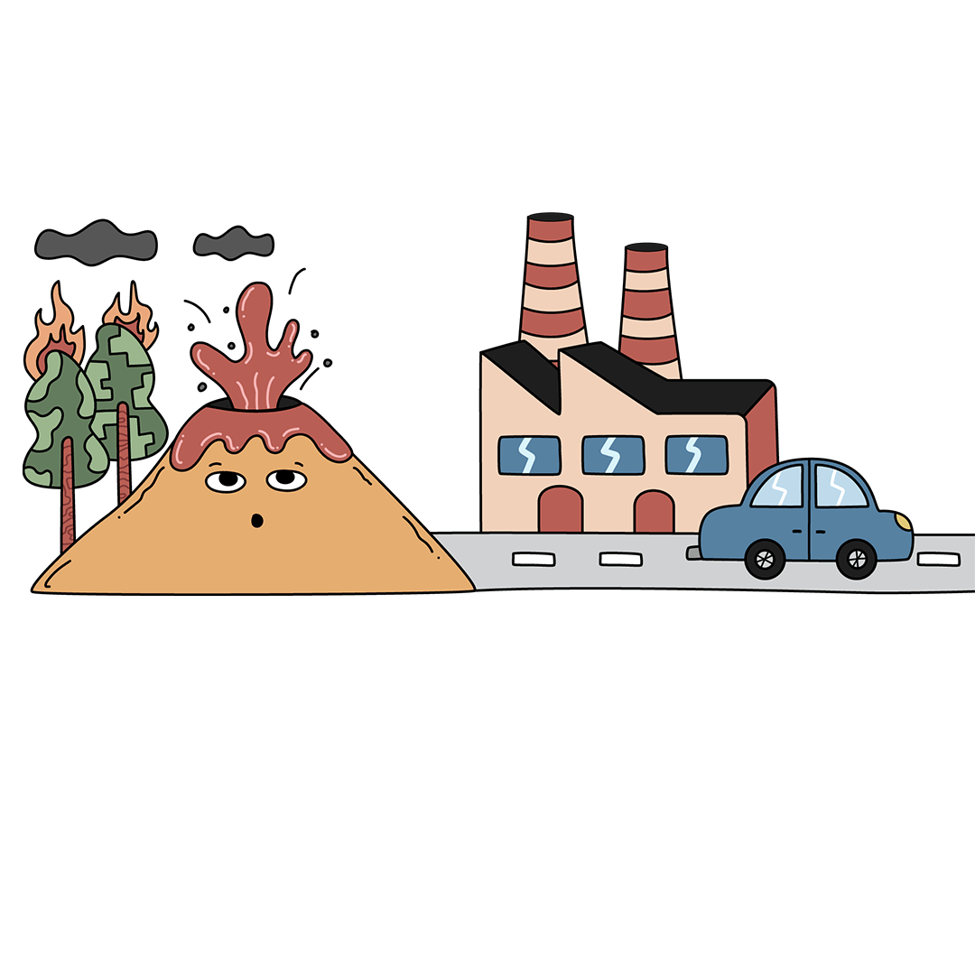
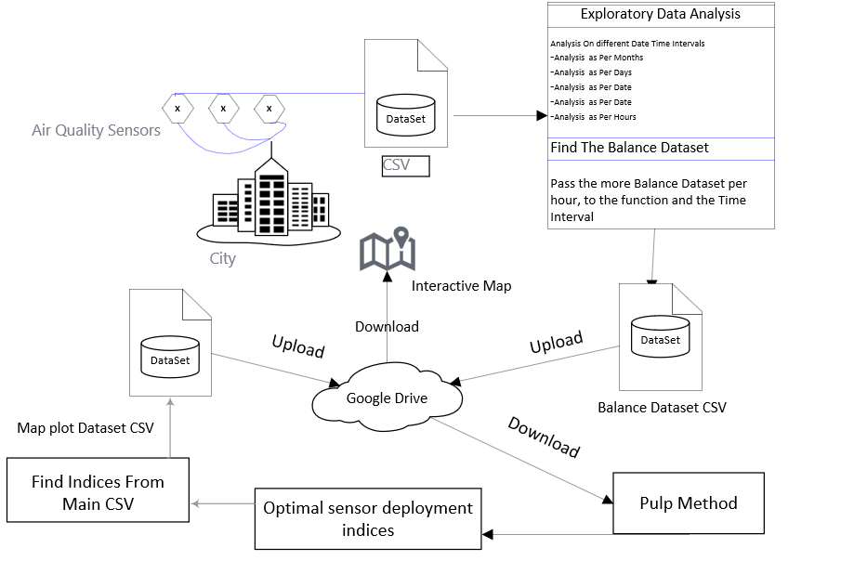
Architecture

Slide 20

Survey
Our | 1 | 2 | 3
dynamic path adjustments based on real-time data and environmental conditions. By integrating ILP and mapping techniques. | Relies on fixed sensor paths determined by predetermined criteria, limiting adaptability and coverage. | Utilizes static sensor deployment strategies without considering dynamic factors, resulting in suboptimal coverage. | Utilizes basic detection models for sensor placement, lacking sophistication in path optimization and adaptability.

Slide 21

Challenges
Scaling with Dataset Size
Sensitive Parameters
Balancing Trade-offs
Resource Allocation
Solution Feasibility
Iterative Tuning

Slide 22

Future Work
Integration of machine learning algorithms for enhanced path optimization and adaptability.
Development of advanced sensing technologies to improve data accuracy and resolution.
Implementation of real-time data analysis techniques for dynamic path adjustment based on changing environmental conditions.

Slide 23
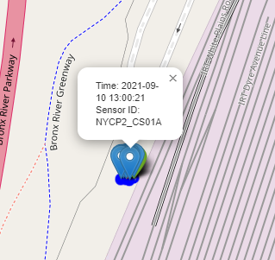
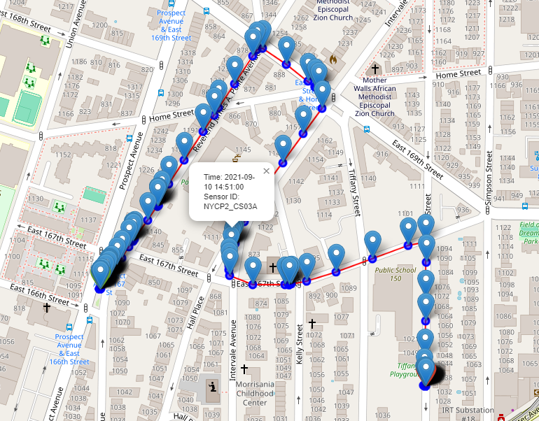
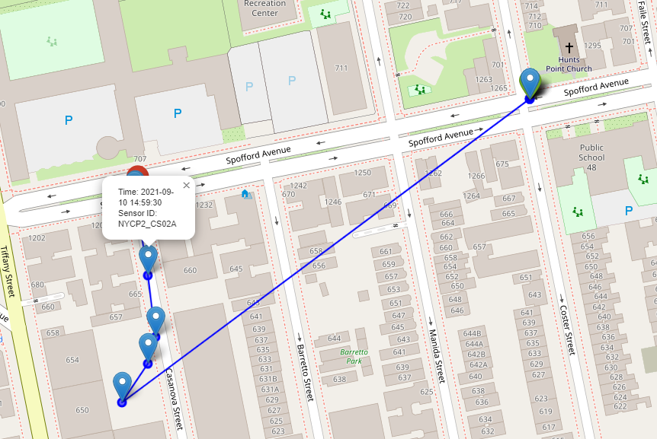
Improvement part3
Using another algorithm: Genetic algorithm (GA).

Slide 24
Thank You

